Slide 1
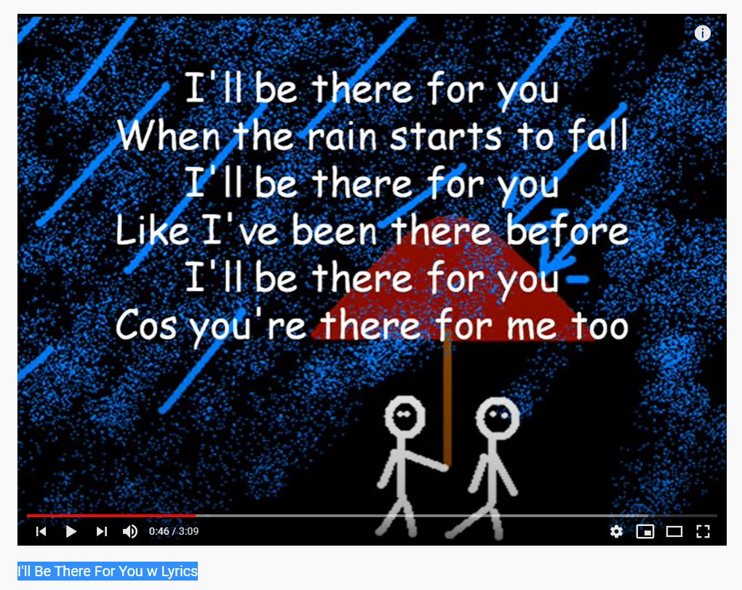

Onlineproject
FRIENDSHIP
3c Englishteam
Standard
MONIKA HUBER
April 2020

Slide 2
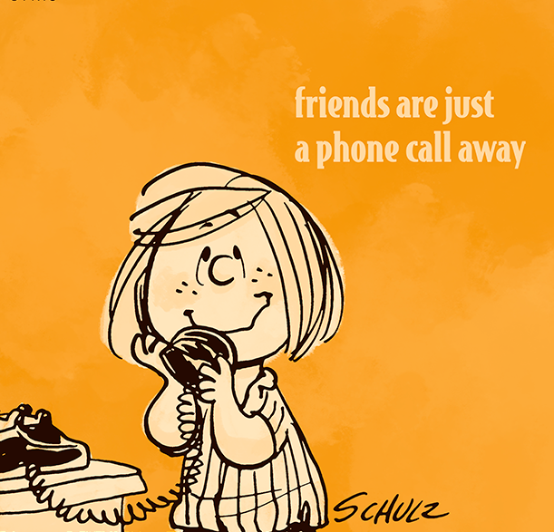

Slide 3
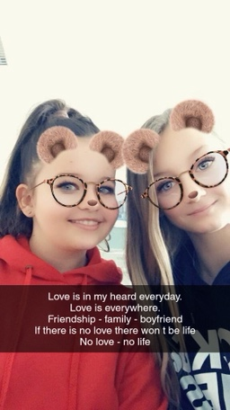
Friends
I think friendship is very important.
I am happy that I have a best friend. In the Corona time I miss my best friend Miriam, but I am happy because we can videophone. But I miss the time we can meet.
In that time I notice that friendship is really very important.
Lena, 15.4.20

Slide 4

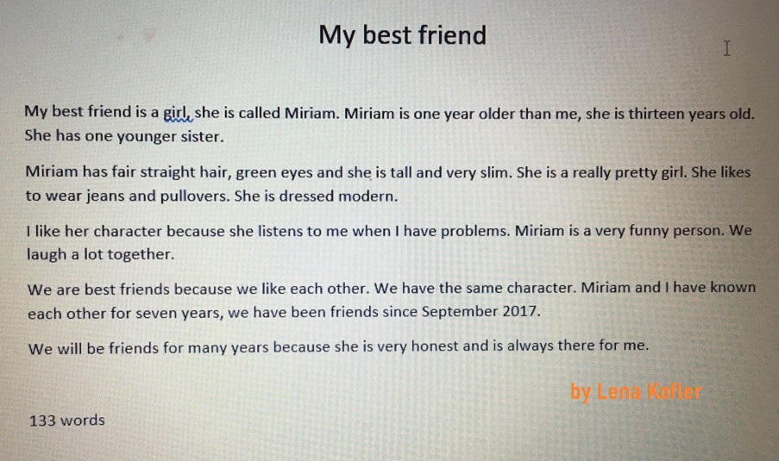
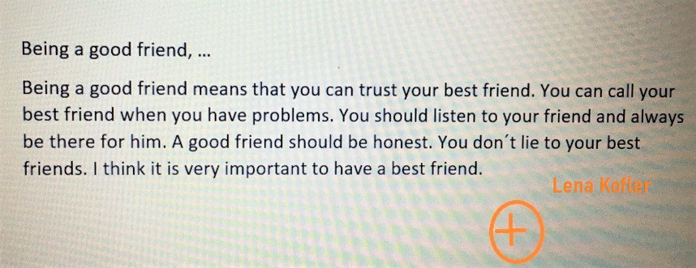

Slide 5
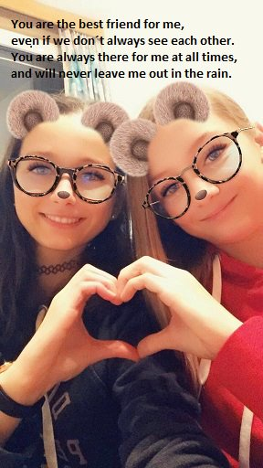
I think friendship is one of the most important things.
I like my friends the way they are.
When I meet my friends we have a lot of fun.
I don´t like the corona situation because I cannot meet with my friends.
I hope the Corona time will pass quickly.
I am really looking forward to seeing my friends in school again soon.
Nina Stoiber, 15.4.20

Slide 6
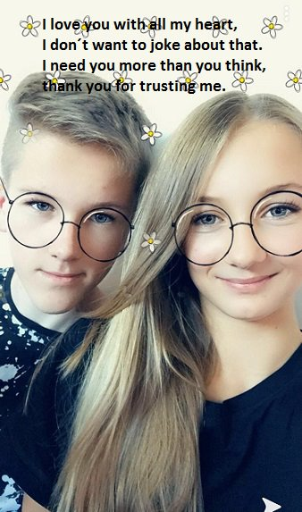
Being a good friend
I think in a good friendship it is important that you are always there for your friend and your friend is always there for you.
When your friend has problems he should come to you and you listen to his problem. When your friend tells you a secret you never tell it other people.
The most important thing is that you never lie to a friend.
Nina, 5.5.20

Slide 7
A text about my best friend
My best friend is a girl. Her name is Nadine and she is eighteen years old.
She is 1.70 meters tall and has long brown hair. She wears glasses, she has a nice face, small lips and little ears. I love her beautiful blue eyes. She has a slender body.
We have been friends for two years. Nadine is like a big sister for me, I like her with all her mistakes. And when I am sad then I have my best friend because she is always there for me. I know that she doesn´t leave me standing in the rain. When I meet me with her, we have a lot of fun and we ___ always laugh. If I tell her a secret, she keeps it to herself. I like Nadine´s character and her sweet smile.
There´s nothing I don’t like about her. She is one of the most important people in my life. I don´t want to lose her. I don’t know what I would do if I didn´t have her. I hope that we will be friends forever.
185 Words
Nina Stoiber, 29.04.2020

Slide 8
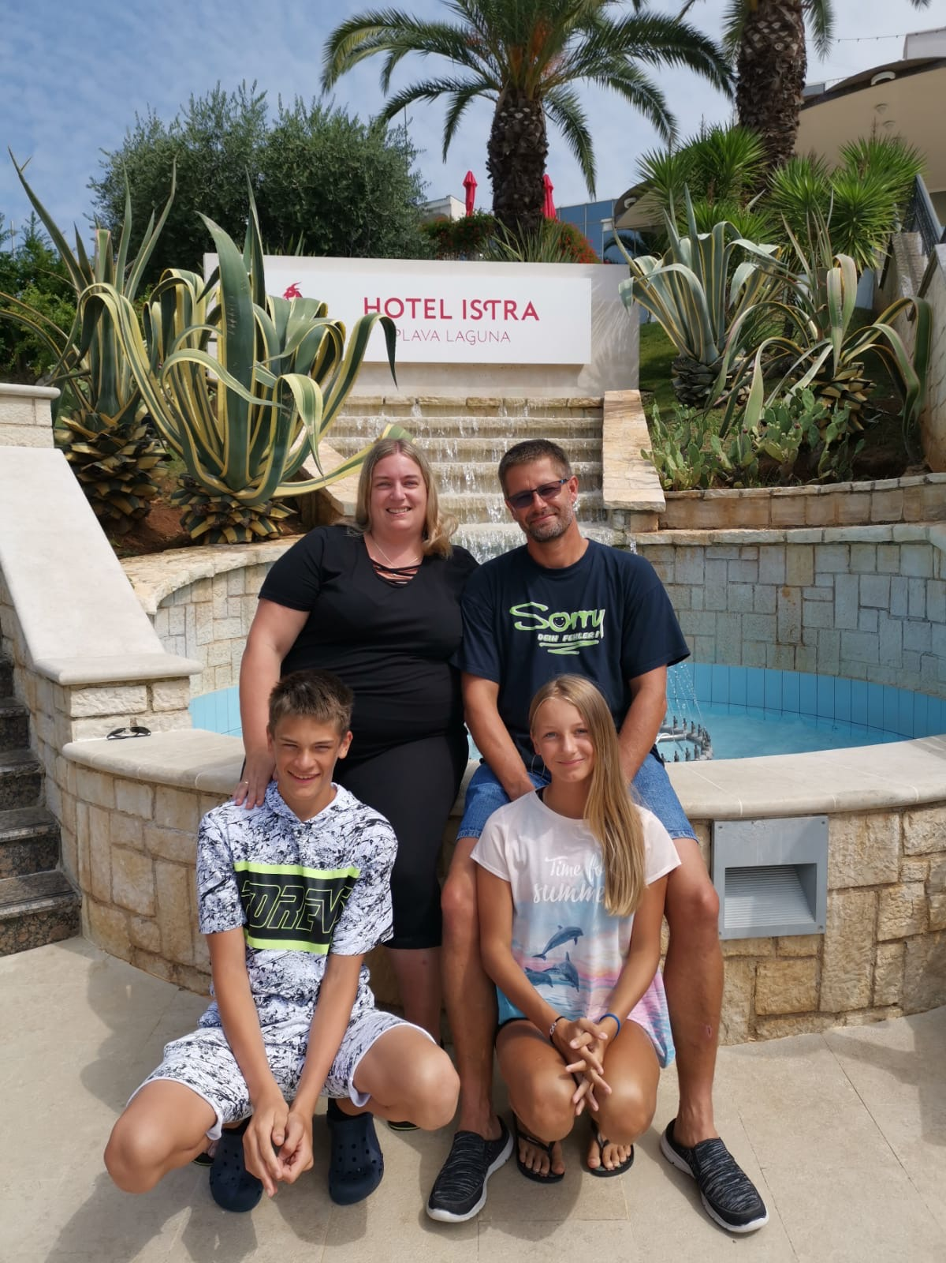

Slide 10
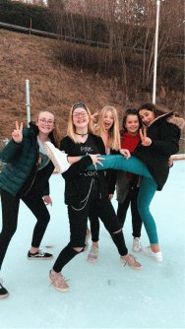
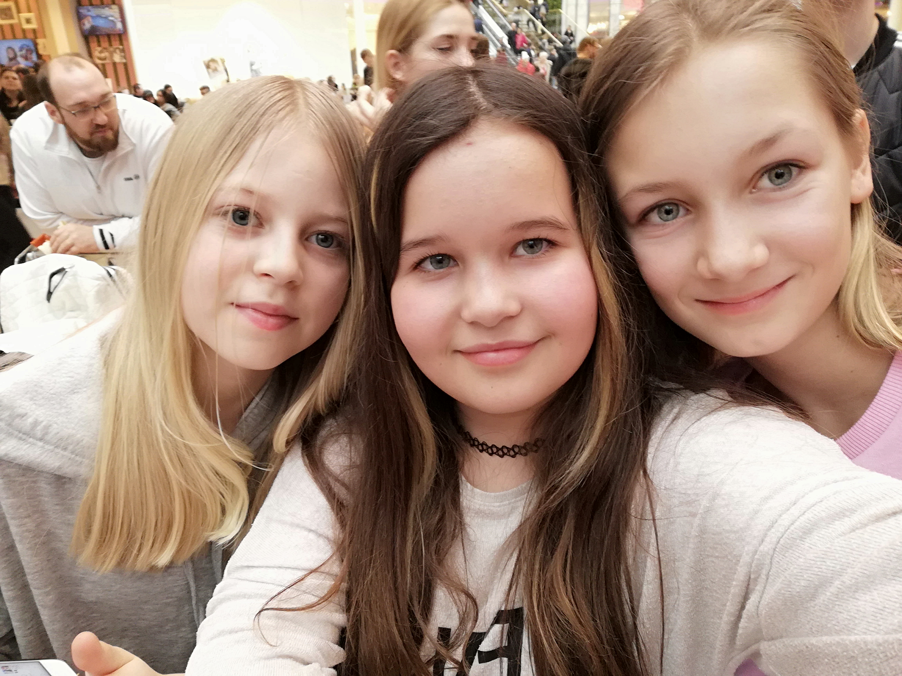
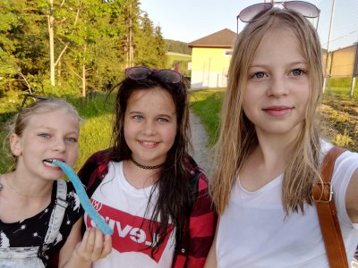
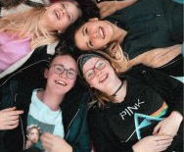
NO LOVE – NO LIFE
Love is in my heart everyday.
Love is everywhere.
Friendship – family – boyfriend
If there is no love, there won`t be life.
No love – no life

Slide 11
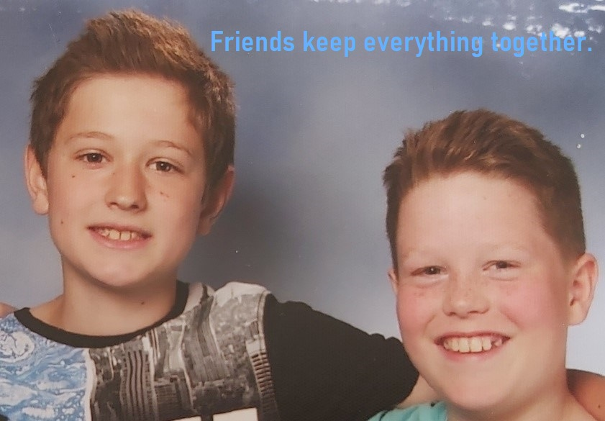

Slide 12
My best friend
My best friend is Felix. Felix is 14 years old and he lives in Zwettl. I know him from school.
When I meet Felix we often play table tennis. I have a great time together with him at school excursions. On Felix´s birthday we went to Salzburg with his dad and have watched a football play. We often play football in my garden. In the summer we often eat ice cream together.
I like Felix because I often meet him and he is a really nice person.
Felix´ parents are really strict and he often does not have his mobile phone.
He is small and thin and has blue eyes. I think he has a nice character because he is really helpful.
I like my best friend Felix.
Manuel, 5.5.20
I think friendships are really important in life.
In the Corona situation I often phone my friends via telephone.
I hope my best friend is honest to me. I often meet my friend and I think it is really nice.

Slide 13
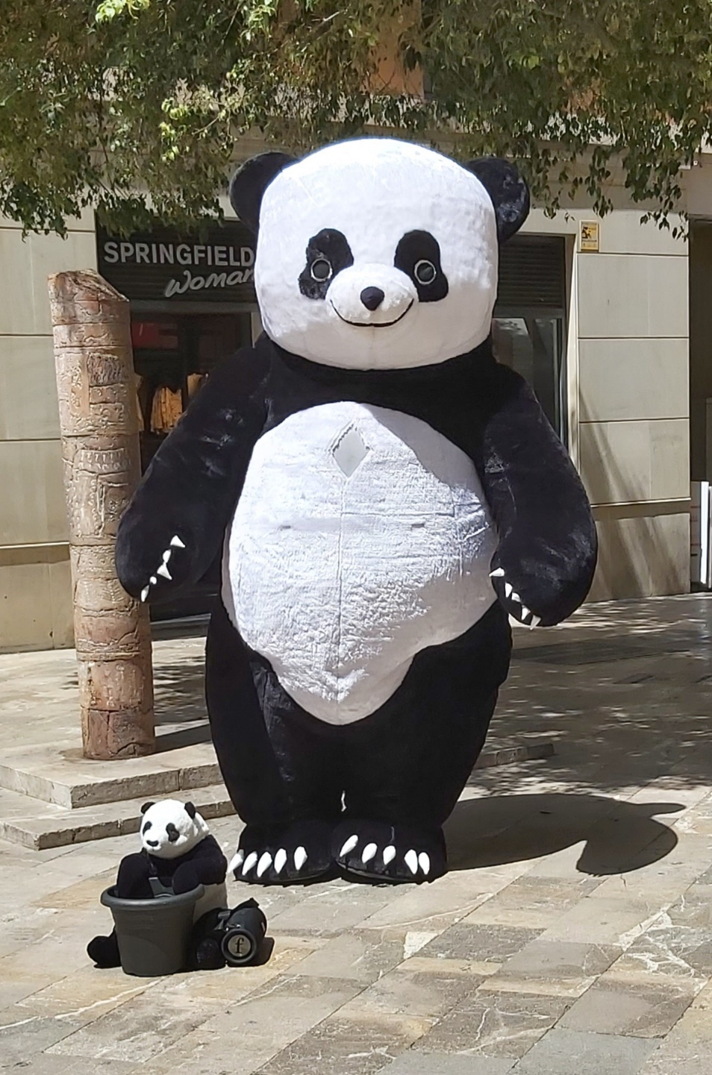
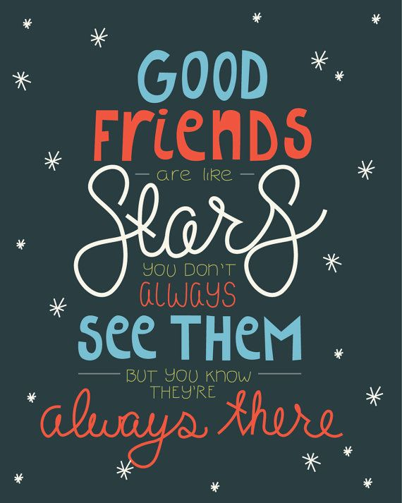

Slide 14

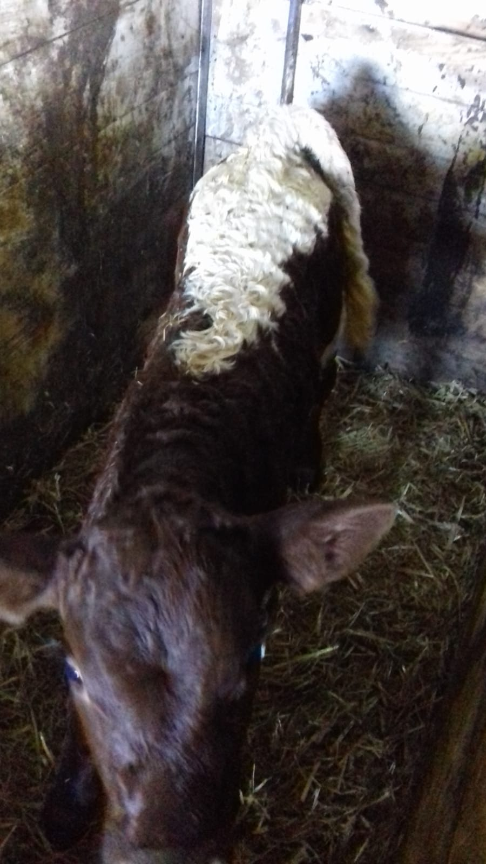

Best F.R.I.E.N.D.S
Find you
Relax me
I miss you
Entertain you
Nice one
Dream of you
See you!
Matthias Birngruber
“Right now I can´t see my friends but this is our little bull Willi.”

Slide 15
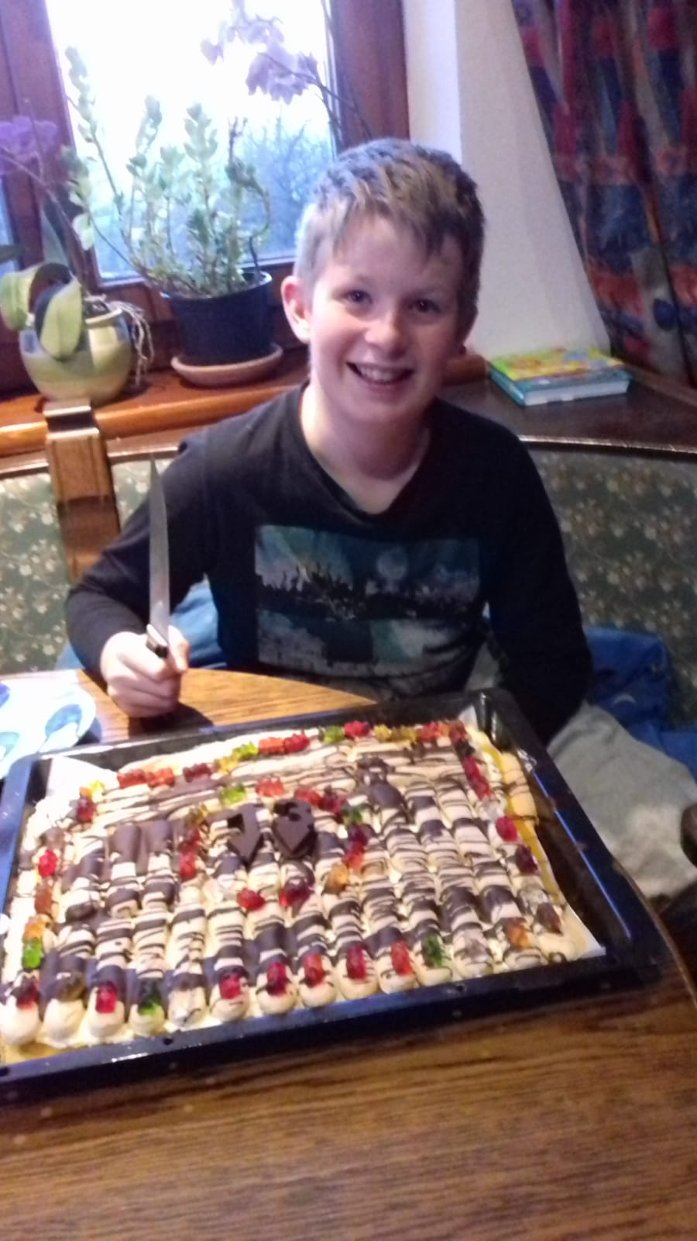
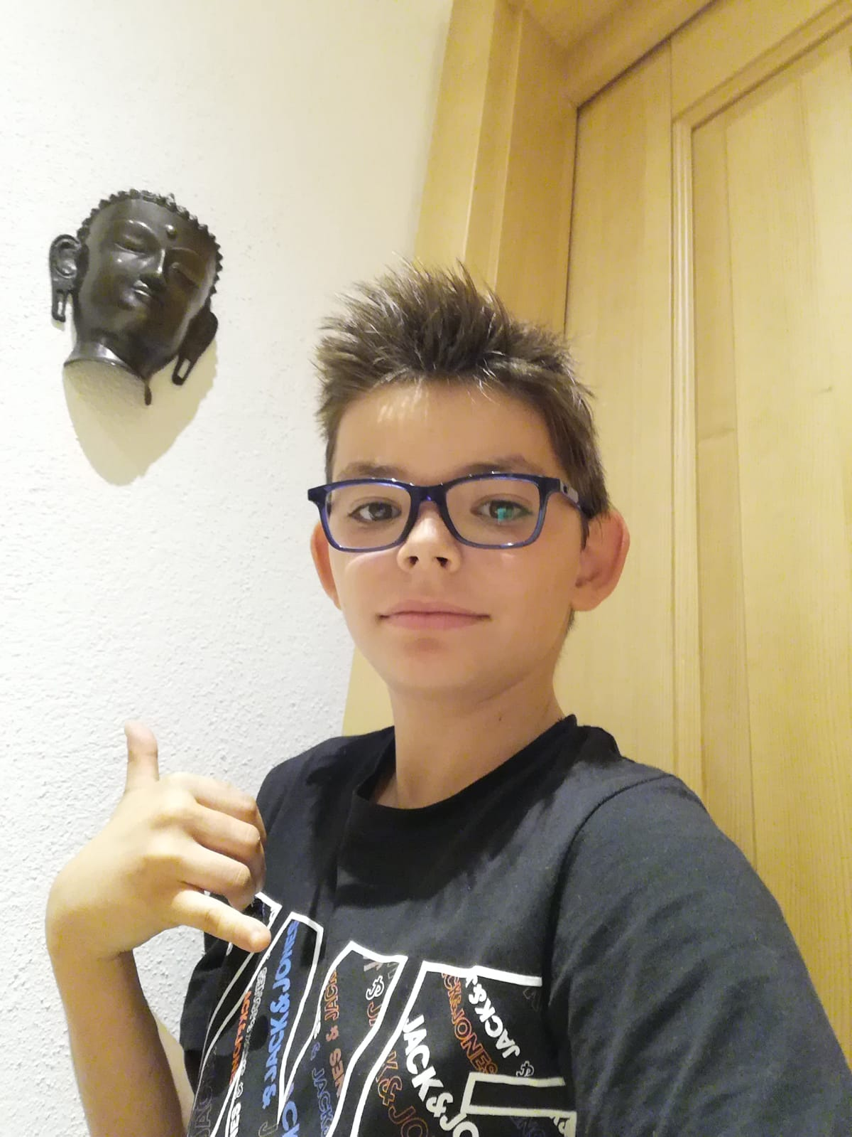

Slide 16
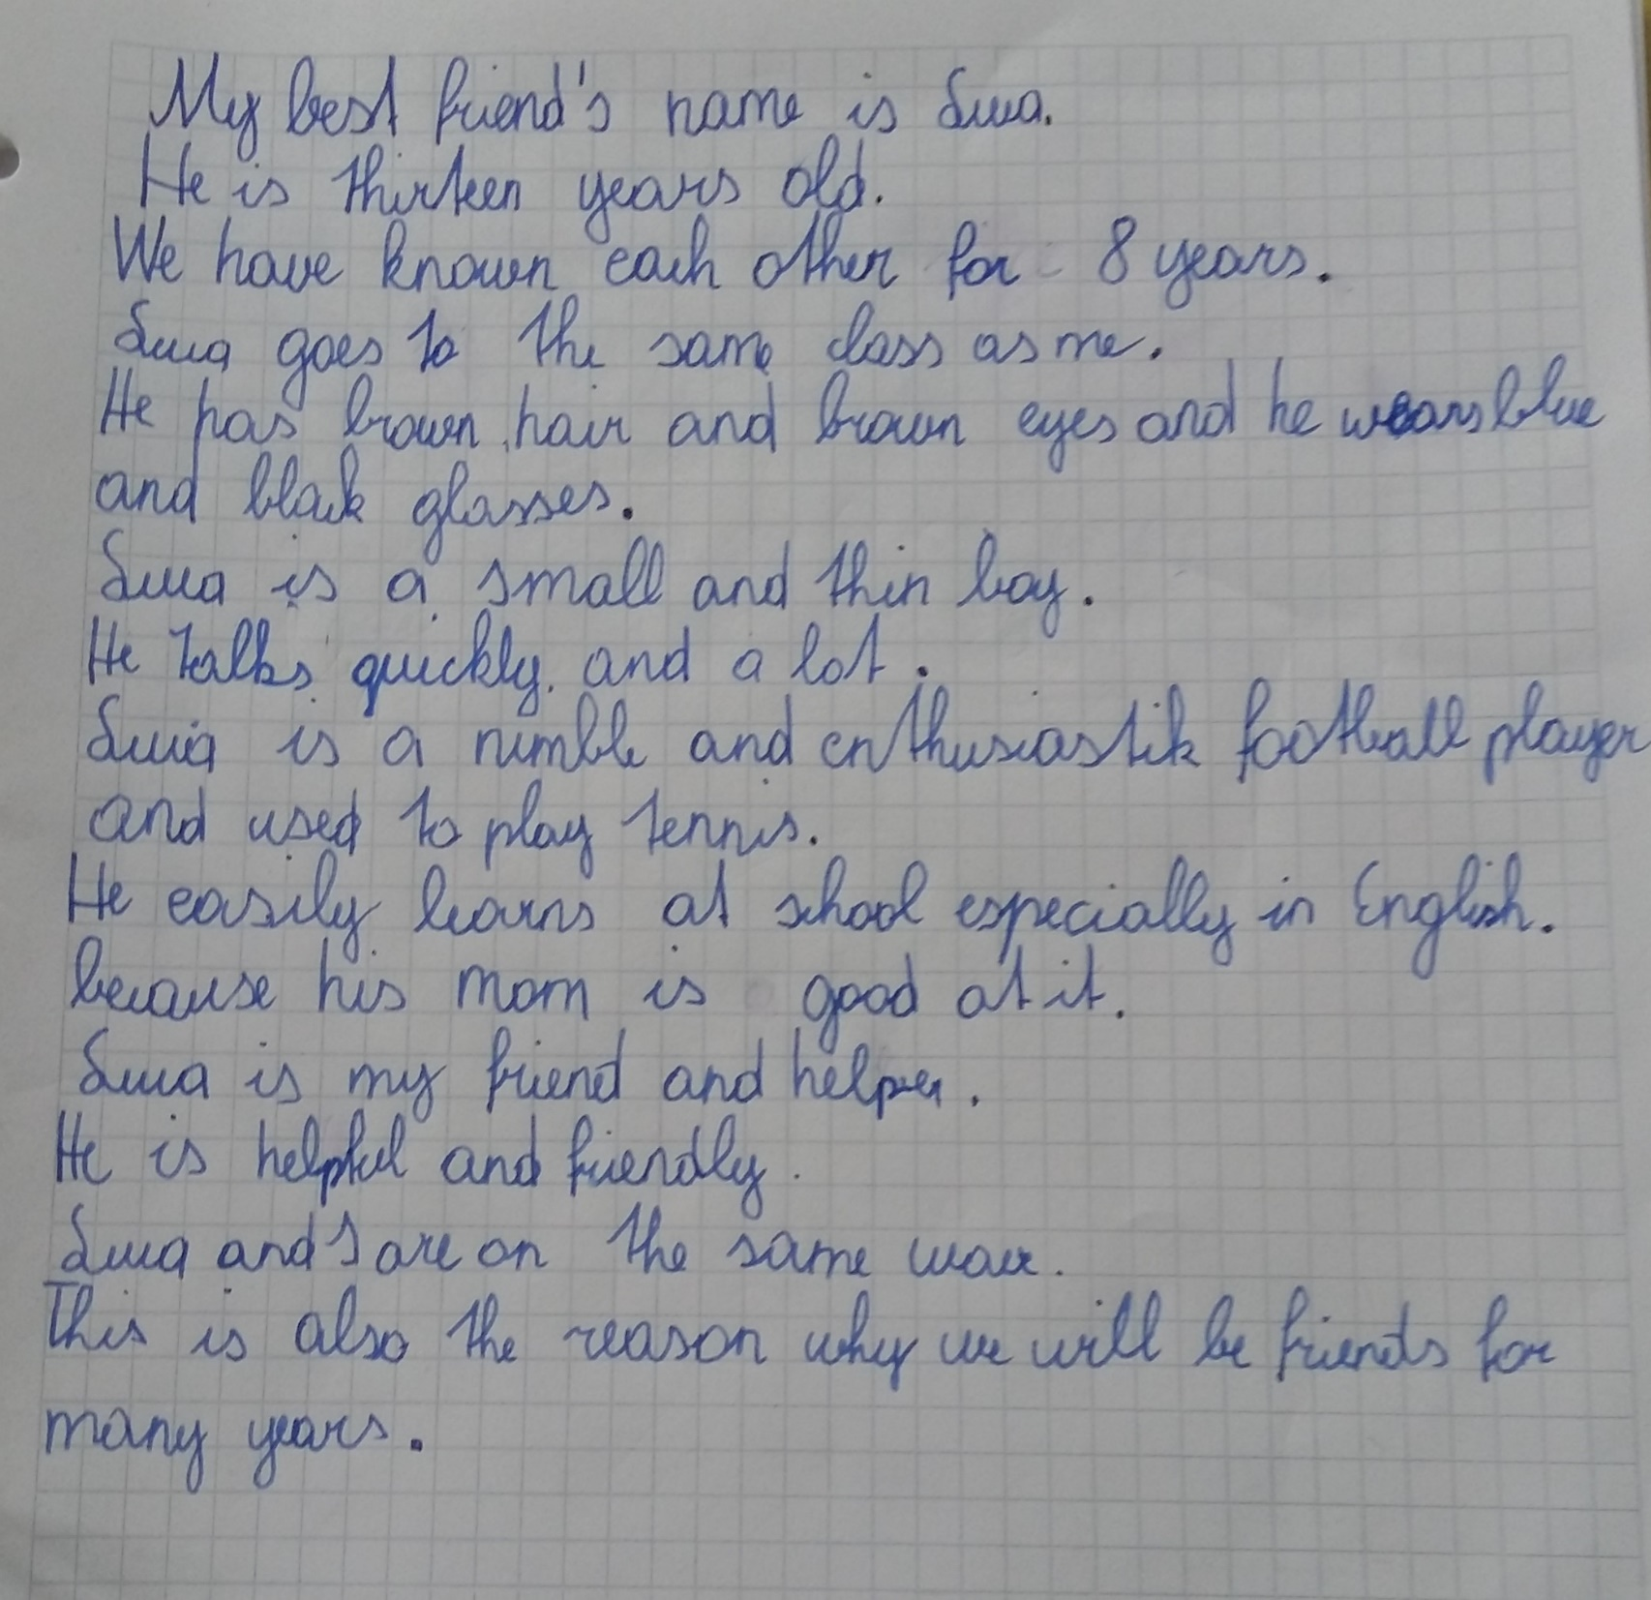
by Matthias

Slide 17
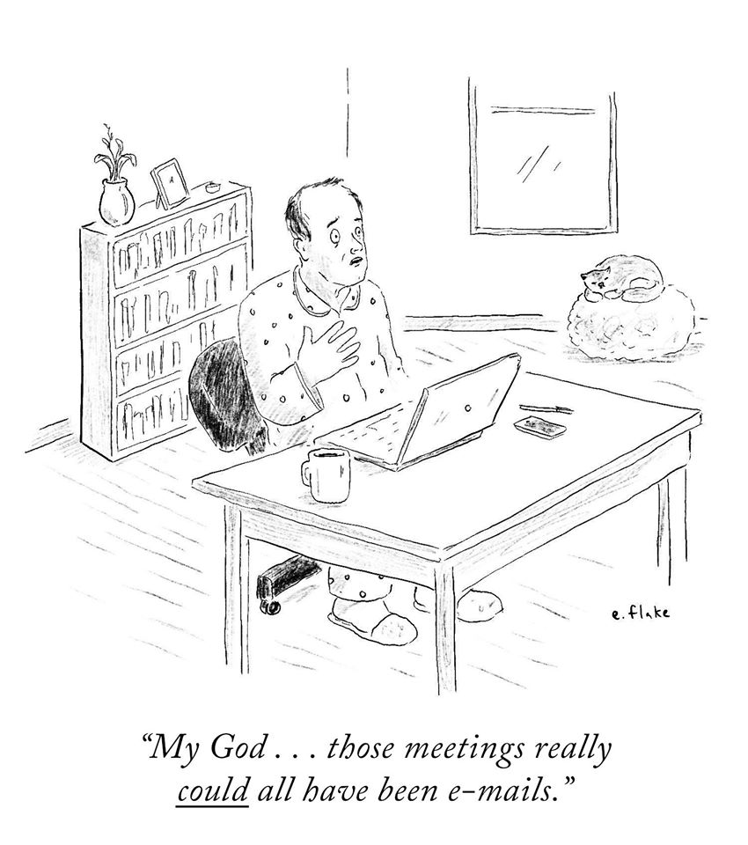
Matthias on the Corona situation:

Slide 18
My situation with Corana
I have many friends, but I cannot see them in this situation.
My friends are very important for me, because I have known them for a long time.
The situation is very boring and not so funny. Playing without my friend is not easy.
In this time I play some games with my friends one my mobile
phone.
I hope the situation will be better in a short time.
Max Eder, 15.4.20

Slide 19
I find the corona situation is not so cool
I call my best friends every day
My best friends are very important for me but I can’t meet them
Moritz Aigner, 15.4.20

Slide 20
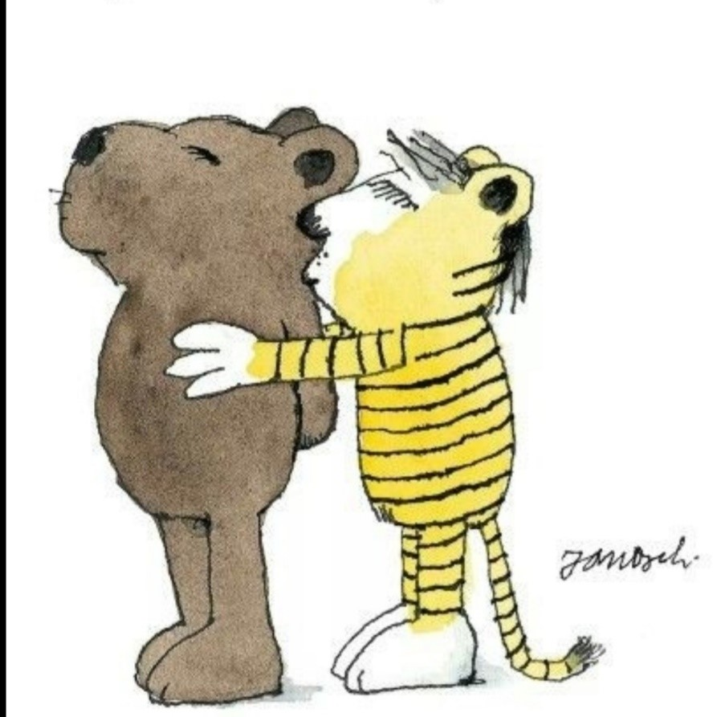
The End

